Slide 1
KIN 482D: Computational modeling of human sensorimotor control and learning
Theoretical models of motor learning
Hyosub Kim, School of Kinesiology

Slide 2
Housekeeping
New option for final projects
Come up with an experiment to test a model – does not require simulations, formal modeling
Does require being rigorous, even without math!
Helper code for problem set 6
Journal Club-like discussion for Smith et al (2006) on Wednesday

Slide 3
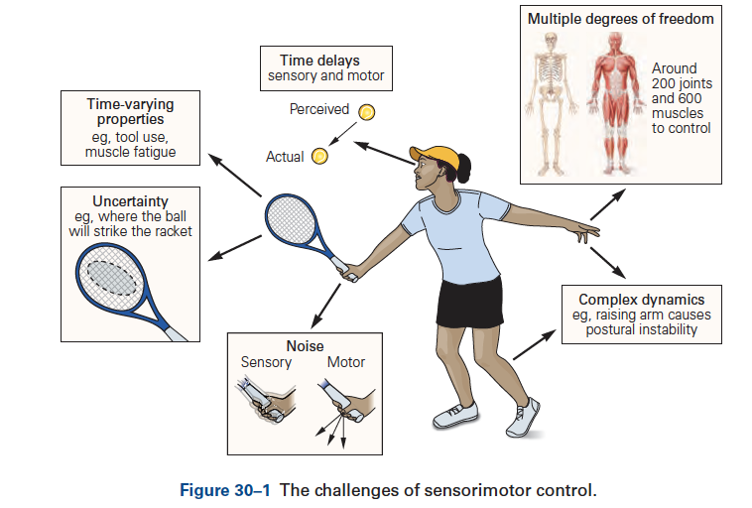
Sensorimotor control is difficult
Note: Figures are from Kandel textbook unless otherwise stated

Slide 4
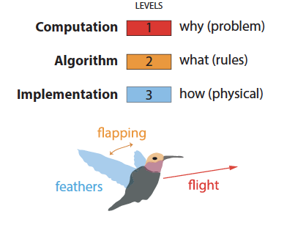
Focus this semester has been on computational level of understanding (why does a system behave the way it does?)
“…trying to understand perception by understanding neurons is like trying to understand a bird’s flight by studying only feathers. It just cannot be done.”
- David Marr (Chapter 1 of Vision)
Marr’s levels of analysis point to the need to understand the why of a behavior—i.e, the computational problem or goal.
Krakauer et al, Neuron 2017

Slide 5
What is motor learning?
Two-part operational definition:
Skill acquisition—the processes by which an individual acquires the ability to rapidly identify an appropriate movement goal given a particular task context, select the correct action given a sensory stimulus and/or the current state of the body and the world, and execute that action with accuracy and precision
Skill maintenance—the ability to maintain performance levels of existing skills under changing conditions
Krakauer et al, Compr Physiol 2019

Slide 6
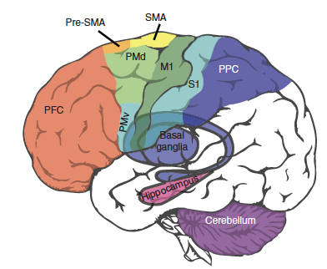
Motor learning is comprised of multiple learning processes
Proposed mapping of different learning processes to specific brain structures. Today, we focus on principles underlying these processes more than the structures.
Krakauer and Mazzoni, Curr Opinion Neurobiol 2011

Slide 7
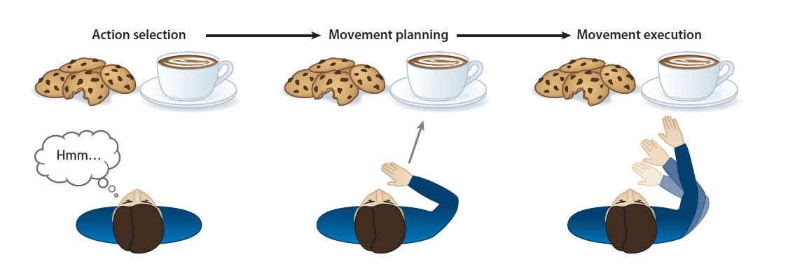
Why reaching?
“…fundamental feature of human competence, underlying capacities as diverse as feeding and object manipulation” (Kim, Avraham & Ivry 2021)
Model task: mixture of low-level control mechanisms with higher level cognition
One of the most well-studied movements

Slide 8
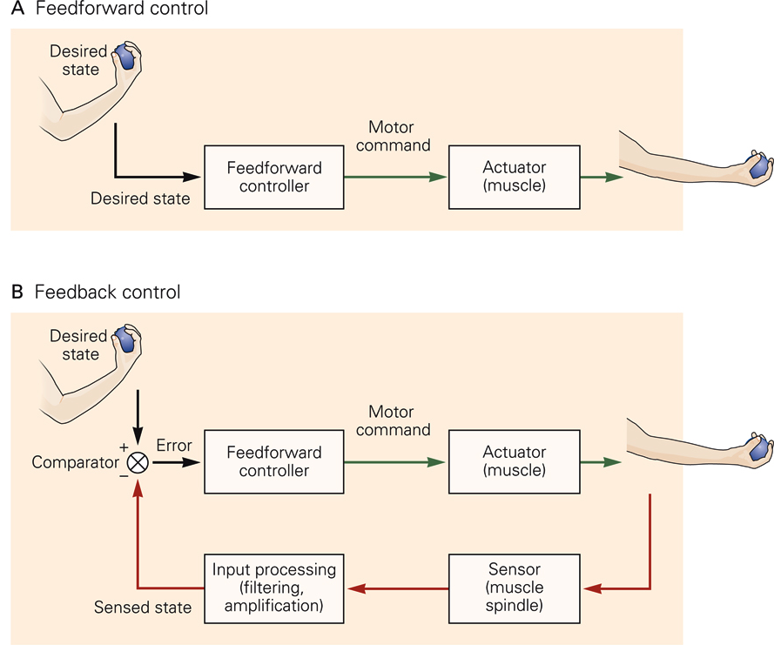
Feedforward (and feedback) control
Most skilled movements require both. Primarily concerning ourselves with feedforward today. However, when it comes to fast goal-directed reaching, a sign of skill is the near total reliance on feedforward control.

Slide 9
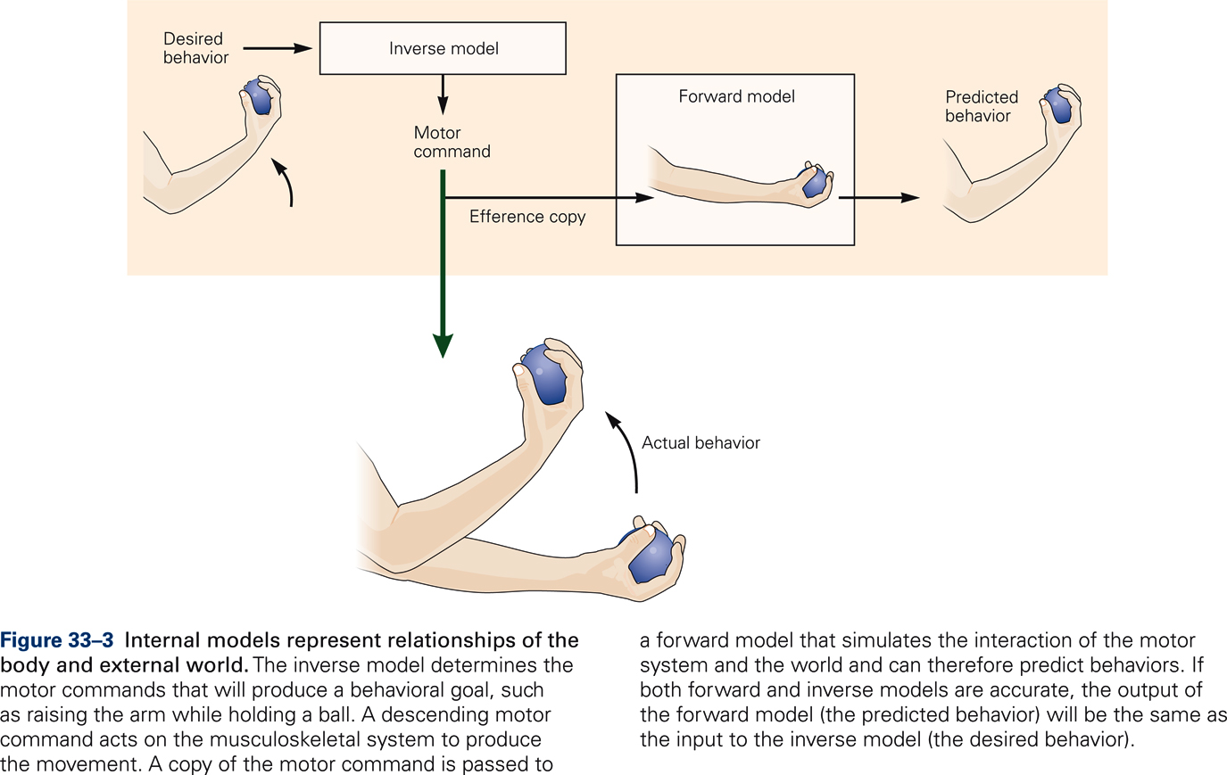
Internal models are critical for control and learning

Slide 10
Sensory prediction errors are teaching signal for adapting internal models (sensorimotor maps)
Krakauer et al., Compr Physiol 2019

Slide 11
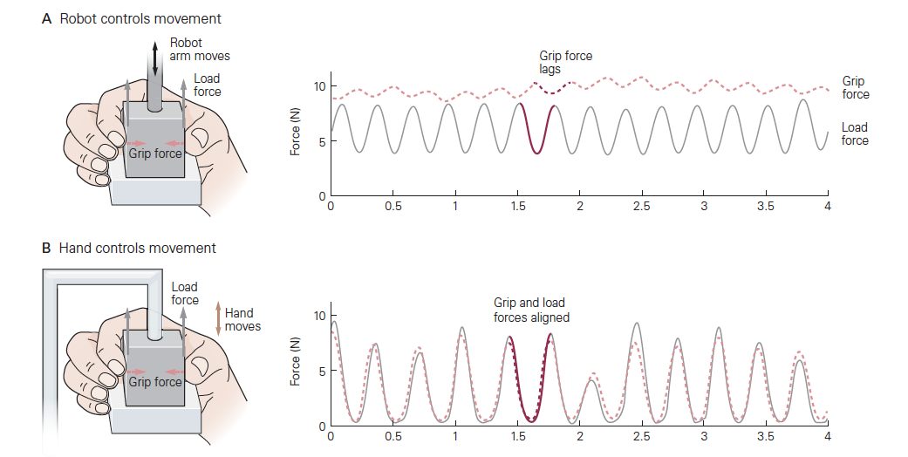
Accurate prediction is key for skill maintenance
Predictive versus reactive control: Load and grip forces are aligned only when subject controls movement

Slide 12
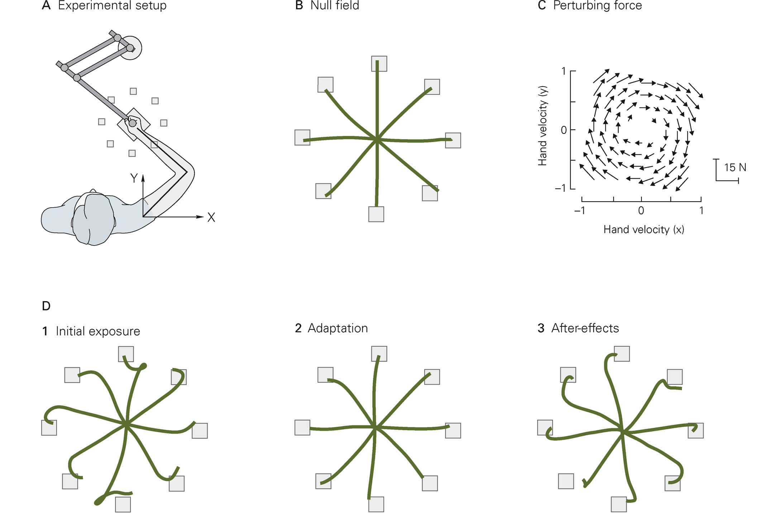
Implicit motor adaptation – learning from sensory prediction errors
Aftereffects are gold standard measure of implicit adaptation – evidence of recalibration

Slide 13
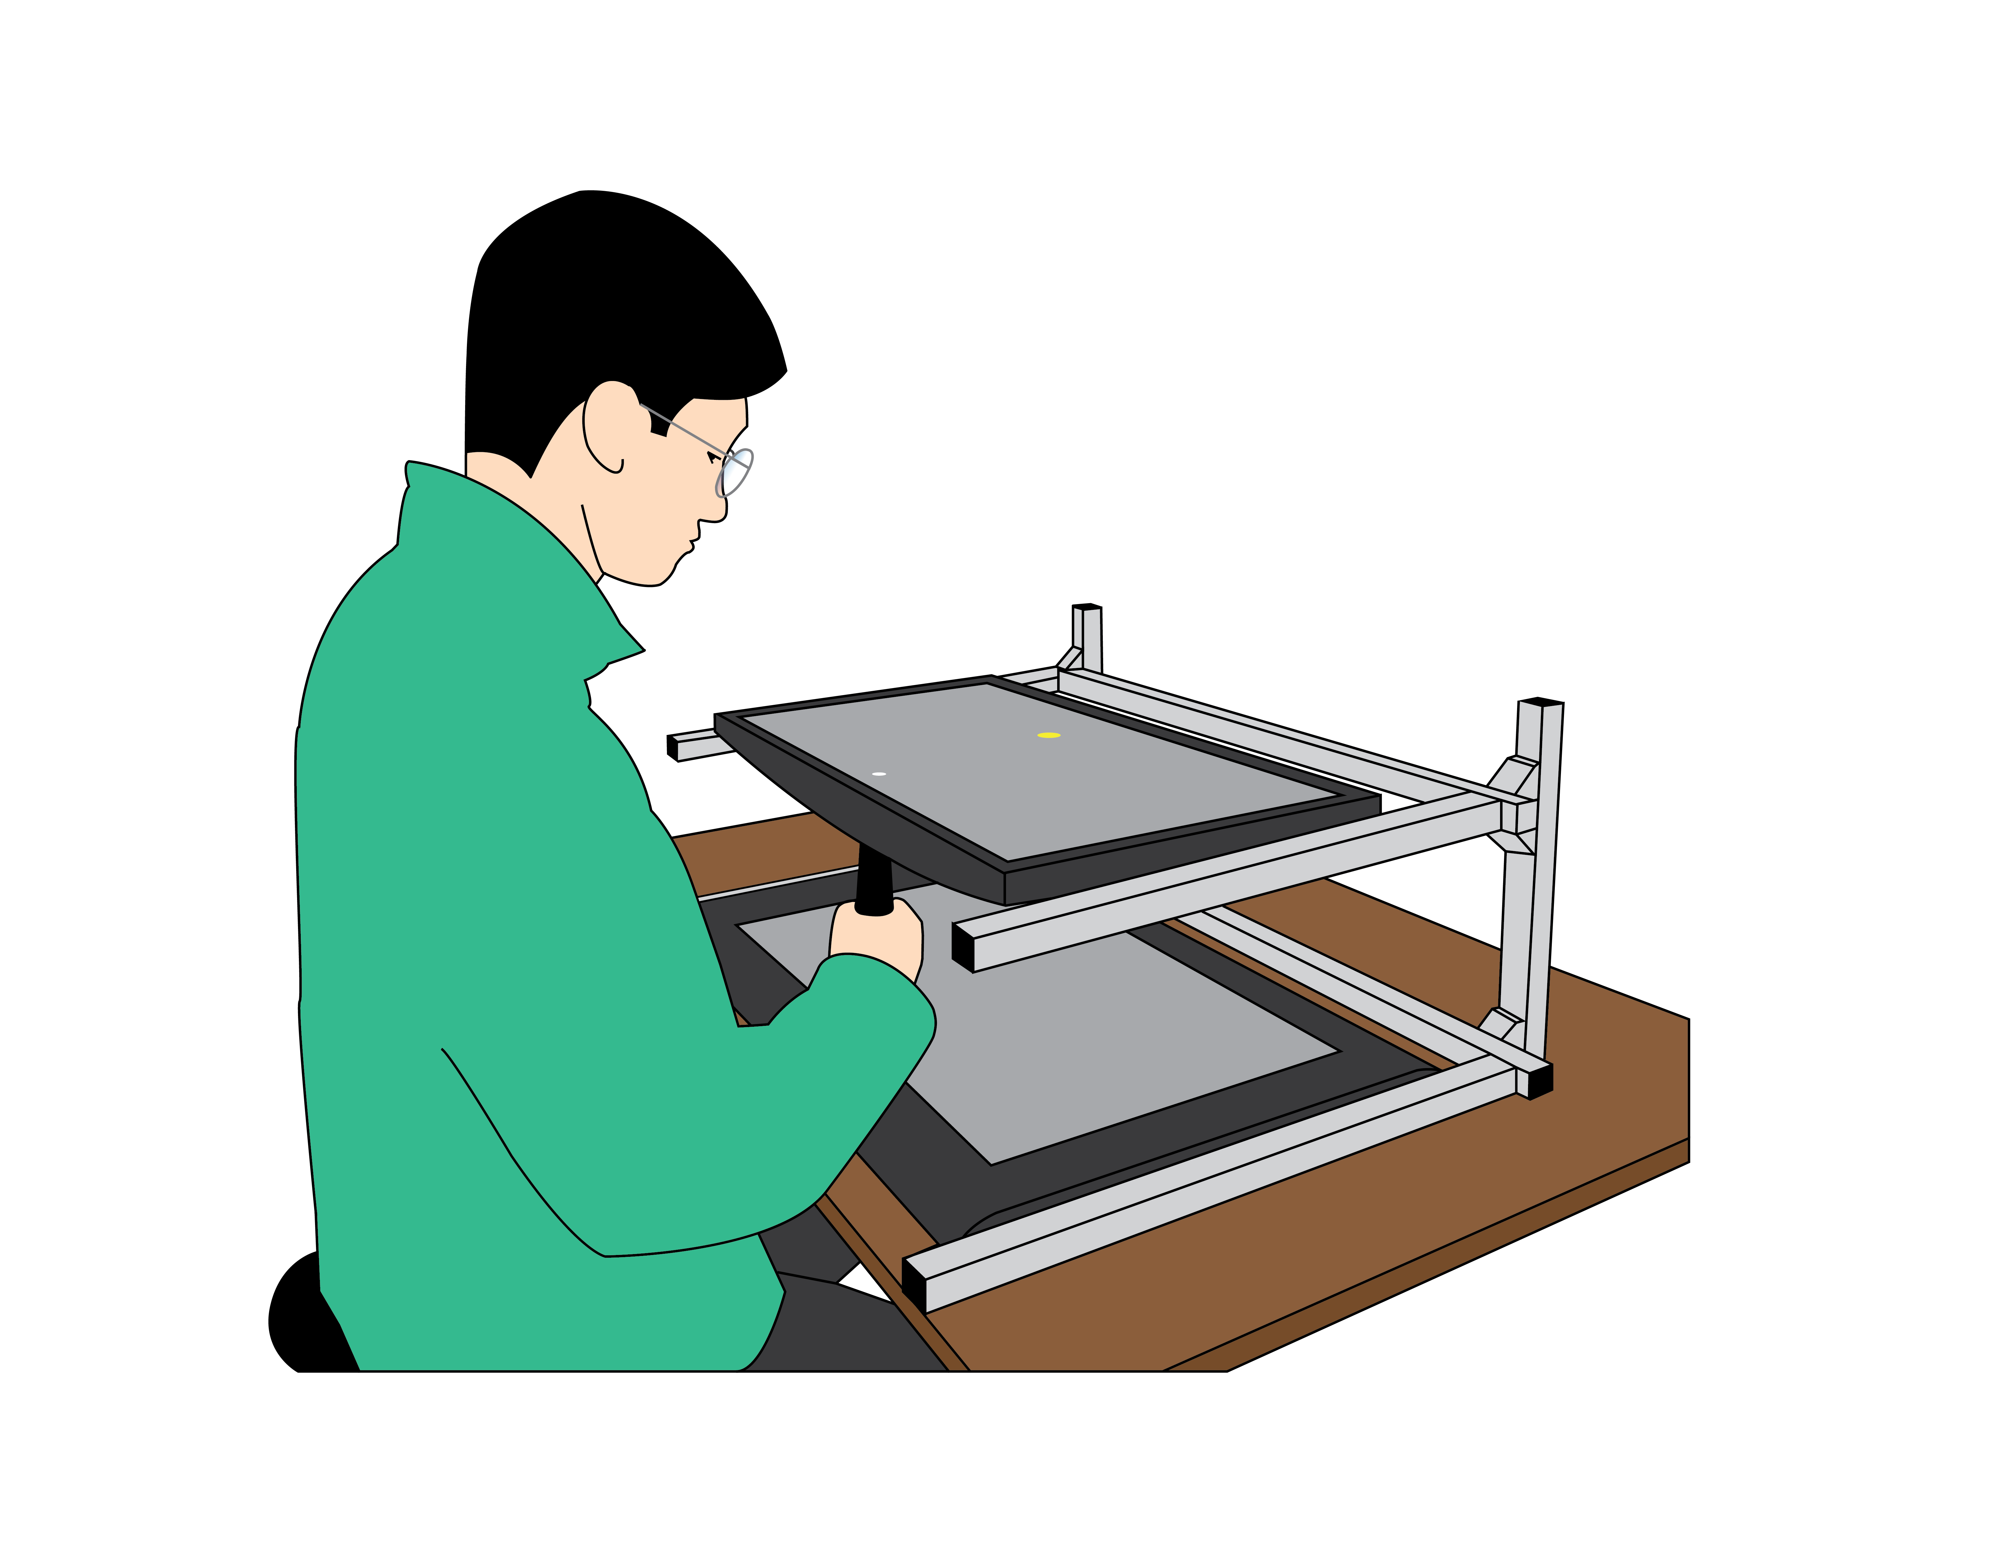
Visuomotor rotation is another way of inducing motor adaptation
Krakauer et al. (2019)

Slide 14
Theoretical Models of Motor Control and Motor Learning (Haith & Krakauer)
“A theoretical approach to motor control and motor learning seeks to explain regularities
in behavior in terms of underlying principles. This typically entails formulating mathematical
models that describe the mechanics of the body or task, the way in which appropriate motor
commands are selected, or the way in which prior experience influences future behavior…”
“A normative modeling approach seeks to explain behavior by first understanding the precise
computational problem that the brain faces, and then asking what, theoretically, is the
best possible way to solve it (akin to Marr’s computational level of analysis). Finding
solutions to such problems typically leverages ideas from control theory or machine
learning. Mechanistic and normative approaches are far from mutually exclusive endeavors…”
- Bayesian models are the prime example of normative modeling!

Slide 15
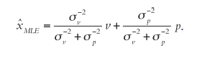
State estimation: making sense of sensory feedback
We must estimate where we are in order to know how to move
What hand location maximizes the likelihood function? Or, ”what hand location is most likely to have led to these observations.”
Authors refer to this as MLE. What do we also know it as? Under what assumption?

Slide 16
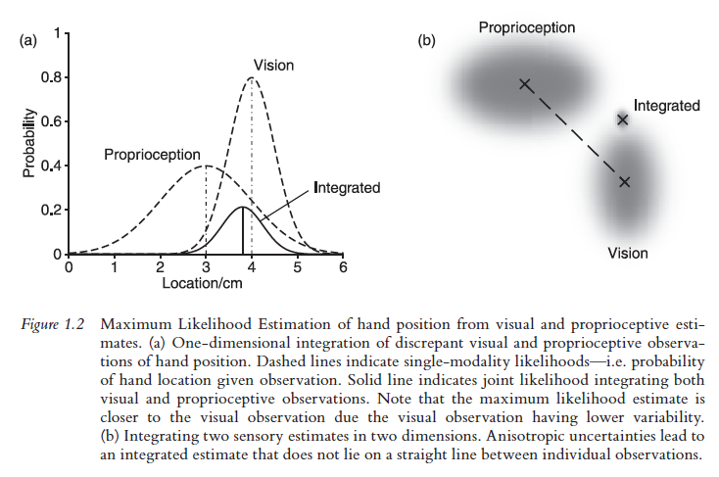
State estimation
*ignore apparent normalization/density issue in figures

Slide 17
Motor learning
“The capacity to learn new patterns of movement and improve and adapt existing ones is arguably the most fundamentally important facet of the human motor system.”
Using visuomotor rotation (VMR) as model task

Slide 18
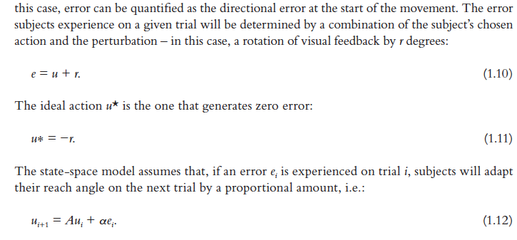
Motor learning: State-space models
A ~ Retention factor; “forgetting” (value between 0 and 1, usually close to 1)
⍺ ~ Learning rate (value between 0 and 1, usually between 0.1 – 0.3)

Slide 19
Motor learning: State-space models
Example of a simple discrete-time linear dynamical system
A system that changes behavior over time, where time (t) is discretized
Linear means only addition and multiplication are involved
Intuitions:
Agent learns to correct for a (fixed) proportion of the error that was experienced during a given trial or movement
Incidentally, this assumption of the model only holds true for a limited range of errors and conditions (see Wei and Kording 2009, Bond and Taylor 2015, Supplement to Kim et al 2018)
The retention factor, A, means that in the absence of error, behavior will gradually return to baseline values

Slide 20
Adaptation leads to short-term changes in sensorimotor maps
Following adaptation to a 30 deg visuomotor rotation and removal of the perturbation, there is reversion to baseline reaching behavior (i.e., washout). Time course of washout follows exponential decay.
Kitago et al, Frontiers Human Neurosci 2013

Slide 21
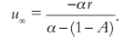
State-space model predicts residual error at asymptote
Simple trick to deriving this expression:
Since we are at asymptote, time-varying terms all have index of infinity
We can do this because, if we are at asymptote, by definition that means that the system is at equilibrium
What this signifies is that the error is never completely removed, an interesting feature of adaptation borne out by many different studies

Slide 22
State-space models summary
Offers a principled way to estimate trial-by-trial learning rates
In general, a model that fits data well is thought to compactly summarize the salient features of the data
Does the SSM provide a computational-level understanding, though?
This is where Bayes comes in!

Slide 23
Beyond state-space models: Learning as estimation
Critical idea in models of motor adaptation is that motor learning is essentially a process of estimating the properties of the perturbation
Korenberg and Ghahramani (2002) showed that proportional error correction is consistent with the idea of updating one’s beliefs (on each trial) about the perturbation in a statistically optimal manner
Kalman Filter, anyone?
The critical difference between this idea and the state- space model formulation is that, in the Kalman filter equations, the learning rate, i.e. the amount one revises one’s beliefs in the light of new observations, is not an arbitrary parameter of the model but emerges as a consequence of the statistics of the task. [mic drop]

Slide 24
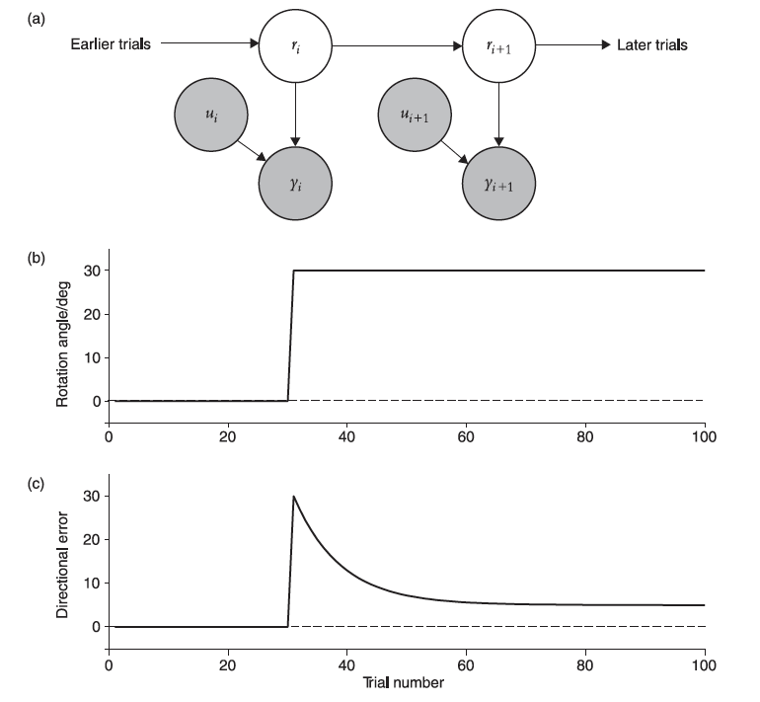
Kalman Filter as a model of motor learning
This generative model represents the subject’s beliefs.

Slide 25
Kalman Filter as a model of motor learning
“The Bayesian viewpoint is, however, much deeper in its implications than a state- space model.”
Implications of the KF model:
Learning rate is dictated by particular aspects of the task: measurement (observation) noise, σ², and perturbation volatility (state transition noise), q²
References to Burge et al (2008) findings: blurring cursor slows adaptation rate, even in a dimension-specific way; increasing state transition noise (“mapping uncertainty”) should increase adaptation rate

Slide 26
Outlook
“Ultimately, the true utility of a normative model is not to provide an overarching theory of everything akin to a fundamental law of physics, but to constrain, inform and inspire new ways of thinking about the motor system across multiple levels of analysis.”

Slide 27
Context for Wednesday’s discussion of Smith et al (2006)
Savings:
Simply means faster relearning after initial exposure to a perturbation/condition/task and washout
Functional significance is that it indicates a memory of what was learned
Force clamp:
In this context, refers to creating a virtual force channel with the robotic device, such that reach trajectories are clamped to the target angle
Allows researchers to measure predictive forces that are generated by subject, without having to control for changing kinematics

Slide 28
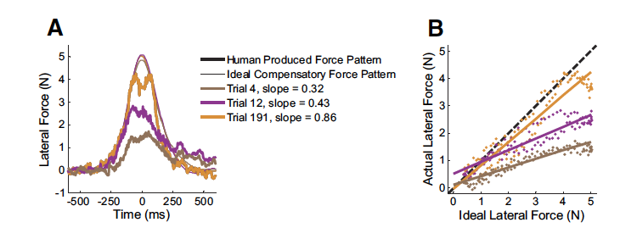
Context for Wednesday’s discussion of Smith et al (2006)
Adaptation index during force field paradigm: estimated slope from simple linear regression of actual lateral force profile versus ideal lateral force profile (perfect adaptation would have slope=1, fall on unity line)
From Joiner & Smith (2008)

Slide 29
For Wednesday’s class…
Read through Smith et al (2006) and be ready to discuss!
Highly influential paper in the field, to this day
Excellent example of a modeling/simulation-based study that incorporates empirical data
One of the best examples of a non-Bayesian model of motor learning (although now we know that there are deep connections between state-space models and the KF)
Continue working on projects

